Slide 1

Dummy Security Architecture review (SAR) Summary Report
STAN the security ARCHITECT
02/03/2026

Slide 2

Agenda
Project Scope
Project Summary
Application Architecture
Application Component Details
Data Flow Diagram
Identified Threats and Remediation
Appendix

Slide 3
Project scope
STAN CONSORTIUM is a cloud-based technology platform that provides ecommerce platforms to vendors.
Application uses Firewall for blocking malicious requests
Application uses a Proxy wall for filtering https requests
Application uses 3-layered architecture
API layer interacts with business logic and backend/database service
Application interacts with third party server
Database server is SQL server

Slide 4
Project summary

Slide 5
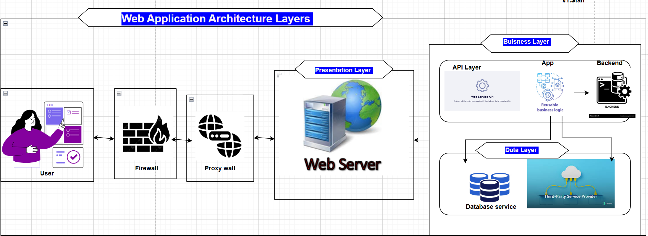
Project Architecture

Slide 6
Application component details
Component Name | Component Description
Firewall | This is a web application firewall that monitors and controls incoming and outgoing network traffic based on predefined security policies. Its primary purpose is to protect the network from unauthorized access and cyberattacks by filtering traffic based on parameters such as IP addresses, ports, protocols, and application types.
Proxy wall | This is a proxy server that is used to act as intermediary between clients and servers on a network, allowing clients to make requests to servers indirectly through the proxy. The use of a proxy server is to provide improved performance by caching frequently accessed resources, enhanced security by filtering and blocking certain types of traffic, and anonymity by hiding the client's IP address from the server.
Web Server | This is an application web server that hosts the application. The web server processes the request, retrieves the necessary resources (such as HTML files, images, or scripts), and sends them back to the client in the form of a response.
Business Layer | The business layer contains the business logic and rules that govern the behavior and functionality of the application, and is responsible for processing and manipulating data in accordance with those rules. It also contains the API Layer, its logic and application implementation
Data Layer | By encapsulating the data storage and retrieval functions within a dedicated layer, the data layer allows for better code organization and promotes modularity, making it easier to modify and update the application's data storage and retrieval functionality without affecting other layers of the application. It also contains the Third Party service.

Slide 7
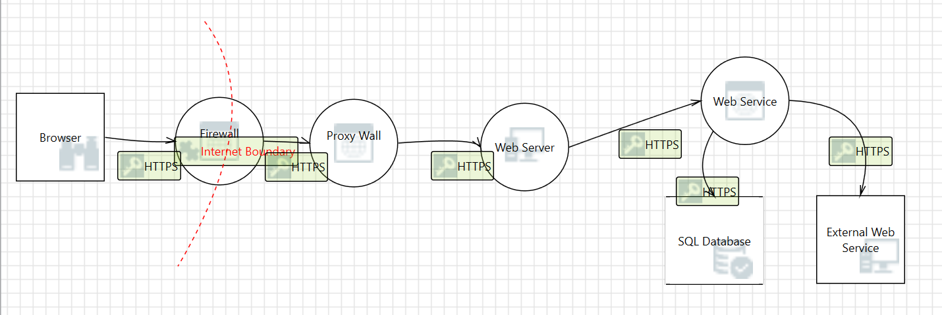
Data flow diagram

Slide 8
SNO | THREAT TITLE | MORE INFO | SEVERITY (Critical, High, Medium, Low) | STRIDE MODEL CATEGORY | SUGGESTIONS
THREAT01 | DDOS not enabled on Firewall | Denial of Service (DoS) involves an attacker attempting to disrupt or disable the normal functioning of a system or network. In the case of a Distributed Denial of Service (DDoS) attack, an attacker can flood a target system with a large volume of traffic, overwhelming its capacity and making it unavailable to legitimate users. If the firewall is not configured to detect and mitigate DDoS attacks, the system may be vulnerable to such attacks, leading to downtime and disruption of service. | Critical | Denial of Service | To mitigate this threat, it's important to implement proper DoS and DDoS protection measures, such as configuring firewalls to detect and block suspicious traffic, using rate limiting and throttling mechanisms, and deploying specialized anti-DDoS solutions. Additionally, regular testing and monitoring should be conducted to identify and address potential vulnerabilities in the system.
THREAT02 | Database is not encrypted | Information Disclosure involves an attacker gaining unauthorized access to sensitive information, such as personal or financial data. In the case of a database that is not encrypted, an attacker could potentially gain access to the sensitive information stored within the database by intercepting traffic, exploiting vulnerabilities, or using other attack techniques. | Critical | Information Disclosure | To mitigate this threat, it's important to implement strong encryption measures to protect sensitive data stored in databases. This may include using encryption algorithms to encrypt data at rest, as well as implementing secure communication protocols to protect data in transit. Additionally, access to the database should be carefully controlled and monitored, and strong authentication and access control measures should be put in place to limit access to authorized personnel only
THREAT03 | User input is not validated at server side | Spoofing involves an attacker impersonating a legitimate user or system in order to gain unauthorized access to resources or to perform malicious actions. In the case of user input not being validated at the server side, an attacker could potentially submit malicious input to the server, pretending to be a legitimate user. This could lead to a variety of security issues, such as injection attacks or privilege escalation. | Critical | Spoofing | To mitigate this threat, it's important to implement proper input validation measures on the server side, such as input validation routines, type checking, and data sanitization. Additionally, access to sensitive data should be carefully controlled and monitored, and authentication and access control measures should be put in place to limit access to authorized personnel only
THREAT04 | Logs are not backed up on a different server | Data Tampering involves an attacker modifying or manipulating data in order to cause harm or gain unauthorized access to resources. In the case of logs not being backed up on a different server, an attacker could potentially tamper with the logs on the original server, which could allow them to cover up their tracks or hide their actions. This could make it difficult or impossible to detect malicious activity, which could have serious consequences for the security of the system. | Critical | Tampering | To mitigate this threat, it's important to implement proper backup and disaster recovery procedures, including regular backups of logs to a separate, secure location. Additionally, access to log files should be restricted to authorized personnel only, and any changes to logs should be carefully monitored and audited.

Slide 9
SNO | THREAT TITLE | MORE INFO | SEVERITY (Critical=0,High=1,Medium=2,Low=3) | STRIDE MODEL CATEGORY | SUGGESTIONS
THREAT05 | Cross Site Scripting | Cross Site Scripting (XSS) is a type of security vulnerability that allows attackers to inject malicious scripts into web pages viewed by other users. If the web server does not properly sanitize user input before displaying it, an attacker could inject JavaScript code that executes in victims' browsers, potentially stealing session cookies, credentials, or performing actions on behalf of the user. This is classified as Tampering because the attacker modifies the intended behavior of the web application. | High | Tampering | To mitigate this threat, implement proper output encoding and input validation. Use Content Security Policy (CSP) headers to restrict script execution. Sanitize all user input before rendering it in web pages. Use HTTP-only and Secure flags on cookies to prevent theft. Employ web application firewalls (WAF) to detect and block XSS attempts. Regularly perform security testing and code reviews to identify XSS vulnerabilities.
THREAT06 | Elevation Using Impersonation | Elevation Using Impersonation occurs when an attacker exploits the web server's ability to impersonate users or services to gain elevated privileges. If the web server runs with high privileges and allows impersonation, an attacker who compromises the server could potentially elevate their access rights beyond what is intended. This could allow unauthorized access to protected resources, administrative functions, or sensitive data that should be restricted. | High | Elevation of Privilege | To mitigate this threat, run the web server with the minimum necessary privileges (principle of least privilege). Disable impersonation features unless absolutely required. Implement proper authentication and authorization checks at each layer of the application. Use separate service accounts with limited permissions. Monitor and audit all privilege elevation attempts. Implement application-level access controls to verify user permissions before granting access to sensitive resources.
THREAT07 | Web Server Process Memory Tampering | Web Server Process Memory Tampering involves an attacker gaining access to modify the memory space of the web server process. If the web server is compromised, an attacker could potentially manipulate variables, inject malicious code, or alter the execution flow of the application directly in memory. This could bypass security controls, corrupt data integrity, and allow the attacker to execute arbitrary code with the privileges of the web server process. | High | Tampering | To mitigate this threat, implement memory protection mechanisms such as Address Space Layout Randomization (ASLR) and Data Execution Prevention (DEP). Keep the web server and all dependencies updated with the latest security patches. Use application sandboxing to isolate the web server process. Implement integrity monitoring to detect unauthorized changes. Deploy intrusion detection systems (IDS) to identify suspicious memory access patterns. Follow secure coding practices to prevent buffer overflow and memory corruption vulnerabilities.
THREAT08 | Elevation Using Impersonation | Elevation Using Impersonation occurs when an attacker exploits the web service's impersonation capabilities to gain elevated privileges. The web service may impersonate calling users to access backend resources, and if not properly configured, this could allow an attacker to escalate their privileges. An attacker who gains control of a low-privilege account could potentially use impersonation to access resources or perform actions that should be restricted to higher-privilege accounts. | High | Elevation of privilege | To mitigate this threat, carefully review and restrict the use of impersonation in web services. Implement constrained delegation rather than unconstrained delegation. Validate that all impersonation tokens are properly authenticated and authorized. Apply the principle of least privilege to service accounts. Implement robust logging and monitoring of impersonation events. Use Kerberos constrained delegation or resource-based constrained delegation where impersonation is necessary. Regularly audit service account permissions and impersonation configurations.

Slide 10
Thank you

